Slide 1

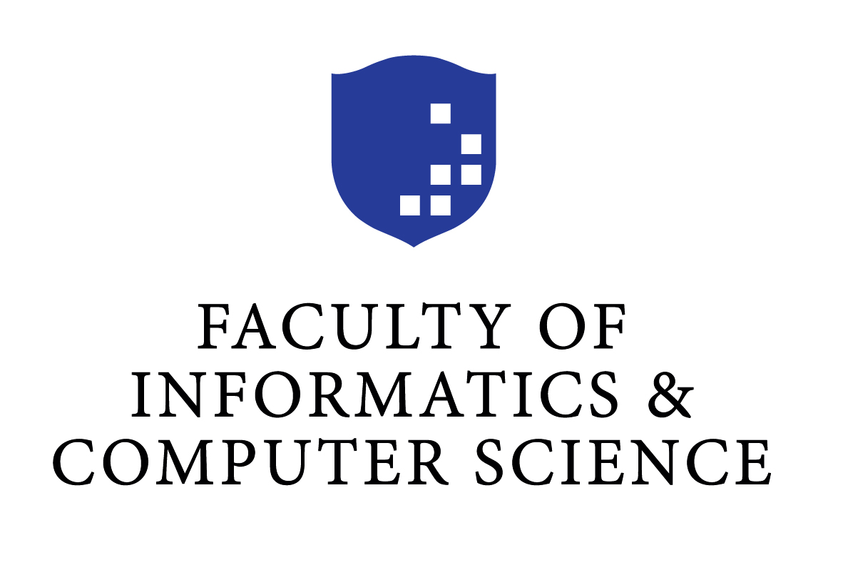
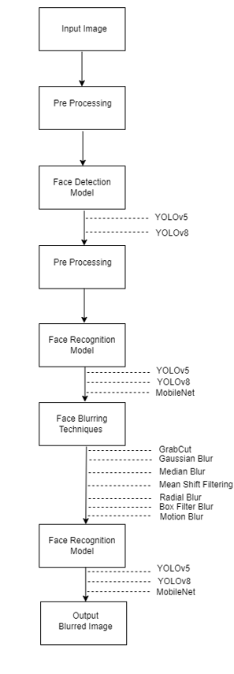
On AI-Driven Privacy Protection: A Study on AI-based Solutions using Face Blurring Techniques by Sara Amjad Sabih Anabtawi 212071 Supervisor: Doctor Amr Ghoneim
Abstract
This project uses AI to automatically detect, recognize, and blur faces in multimedia content, enhancing privacy protection. I experimented with YOLOv5, YOLOv8, and MobileNet for face recognition, and various blurring techniques to ensure faces were effectively obscured. Despite dataset limitations, the LFW and Avengers datasets were used, and models were retrained to improve performance. YOLOv5 achieved a precision of 0.982 and recall of 0.965, while YOLOv8 showed similar results. This project offers a unique approach to safeguarding personal privacy in the digital age.
System Design/ Interface
Results
In this project, YOLOv5 achieved a precision of 0.982, recall of 0.965, mAP50 of 0.991, and mAP50-95 of 0.849, while YOLOv8 showed similar performance with a precision of 0.983, recall of 0.961, mAP50 of 0.99, and mAP50-95 of 0.839. For face recognition, MobileNet achieved high accuracy, consistently outperforming other models.
Conclusions
This project developed an AI-based system for face detection, recognition, and blurring to enhance privacy. Experiments included YOLOv5 and YOLOv8 for face detection, and YOLOv5, YOLOv8, and MobileNet for face recognition. Blurring techniques such as Gaussian blur, Median blur, and Motion blur, both individually and in combinations, were tested.

